Slide 1

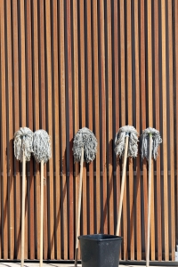
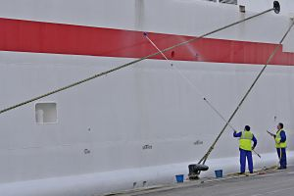
Clean and Maintain Industrial Work Area and Equipment
Unit Code: D1.HHK.CL3.07
Slide 1
Notes:
Trainer welcomes trainees to class and introduces the module.
1

Slide 2
Introduction
Before undertaking any cleaning, it is important to identify:
All areas of the property that require cleaning
The scope of cleaning required
The time of day when cleaning can be undertaken
How often certain areas need to be cleaned
Types of surfaces to be cleaned
Slide 2
Notes:
Class activity 1
Trainer should explain that all properties are different.
Trainer should have the students discuss different types of public buildings and identify all areas within that would require cleaning e.g. School, Church, Bank, Railway station.
Have the students talk about the different traffic flows and expectations of visitors to these places.
2

Slide 3
Why is it necessary to clean?
Local Health and Safety Regulations
Customer experience and expectations
To maintain safety within the property
To prevent outbreaks of food poisoning
To prolong and maintain the investment of all assets
Staff morale
Slide 3
Notes:
Trainer to investigate local regulations as they relate to cleaning of premises and share these with students.
Give some examples of where local businesses have had to close through lack of safety or food poisoning outbreaks (newspaper cuttings) and any legal action that followed.
3

Slide 4
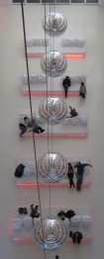
Identify Work areas to be cleaned
In all properties and sites there are both “back of house” and “front of house” areas.
Front of House is defined as areas where customers or guests have access to
Back of House is defined as areas where the customer or guests do not have access to. It is usually the places where staff do their operational work
Slide 4
Notes:
Trainer to discuss briefly.
Class activity 2 - have the students think about their workplace and what they define as front or back of house. Discuss if there is any difference in cleaning standard and if so why?
4

Slide 5
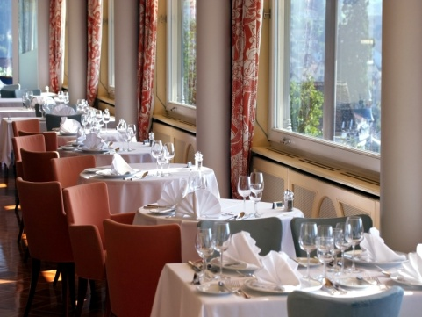
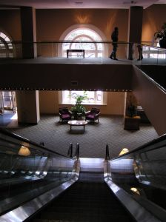
Examples of Front of House areas
Lobbies and Reception areas
Restaurants and Bars
Corridors, Lifts and public toilets
Function rooms
Gyms and swimming pools
Car parks
Slide 5
Notes:
Trainer to explain that Housekeeping will clean all these areas at different times. The pH level of swimming pool water however will be checked and controlled by maintenance staff.
5

Slide 6
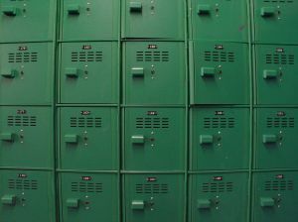
Examples of Back of House areas
Kitchens
Staff cafeteria
Staff locker rooms
Administration offices
Staff toilets
Laundries and linen rooms
Store rooms
Delivery bay
Slide 6
Notes:
Trainer to explain that back of house areas are where staff work and to where guests do not have access.
Kitchens may be cleaned by a team of stewards who report directly to the Executive Chef
In small motels however, cleaning may be undertaken by housekeeping staff.
6

Slide 7
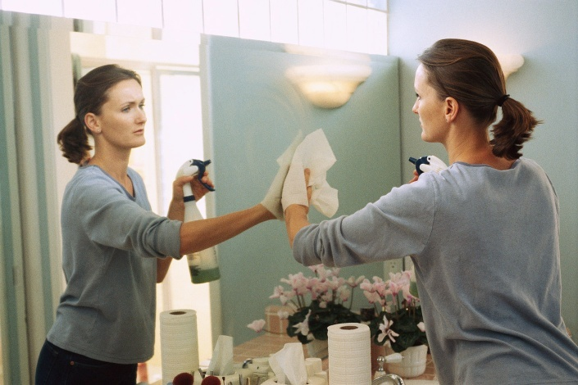
What items do we clean?
Every item and surface must be cleaned either:
Daily
Several times daily
Weekly
Periodically
On request
Slide 7
Notes:
Class activity 3
Trainer to have groups of students assigned to one area in their workplace and identify each item, each surface type and how often they think each item would need cleaning.
Consider the volume of customers and staff expectations
Discuss the students’ findings as a whole.
7

Slide 8
Types of surfaces
Carpet
Wood
Marble
Brass
Glass
Granite
Ceramic
Terrazzo
Clay Tiles
Leather
Metal
Concrete
Vinyl
Stainless Steel
Laminate
Fabric
Plastic
Paint
Slide 8
Notes:
Based on Activity 3, trainer should show students some examples of where all the above may be located so that students can recognise all types of surfaces.

Slide 9
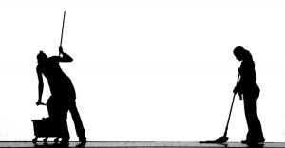
Cleaning Terms
Daily Cleaning
Weekly Cleaning
Task of the Day
Team Cleaning
Periodic Cleaning
Slide 9
Notes:
Trainer to explain these terms and how they relate to frequency of cleaning.

Slide 10
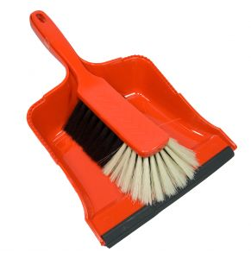
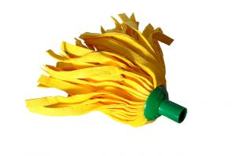
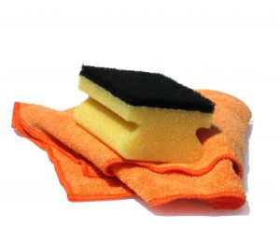
How will I know what to clean?
Task description
Job schedule
Log book
Via pager or mobile phone
Supervisor
Slide 10
Notes:
There will be a variety of communication tools in the workplace.
Trainer should discuss these and ask the students if they have any more examples.
Discuss the importance of good communication and its effect on customers if there is a breakdown on communicating cleaning requirements
On occasions other staff will make cleaning requests directly to the cleaners for action
Always refer these requests to your supervisor as they will need to know what you are doing and possibly why other cleaning tasks have not been completed.
10

Slide 11

What other information will I need?
How to use cleaning equipment
How to use the cleaning chemicals
How to report faults in machinery
How to report general maintenance issues
Slide 11
Notes:
Trainer to obtain samples of MSDS, colour wall charts, and technical bulletins for chemicals and discuss each one in detail.
Class activity 4
Have the students design a maintenance request procedure and reporting form.
11

Slide 12
When and what to clean
Scope of cleaning
Timing of the cleaning
Slide 12
Notes:
Trainer to discuss this in relation to trading rosters and requirements of this cleaning.
12

Slide 13

The cleaners role in maintaining security
Keys
Alarms
Lighting
Report unusual activities
Report property damage
Hand in lost property promptly
Slide 13
Notes:
Trainer to emphasise how important this role is. They must help to secure the building and its assets.
Trainer to stress the importance of the care of keys and assets.
Discuss in detail the reasons for reporting unusual activities and have the students discuss their experiences in the workplace in relation to security issues.
13

Slide 14
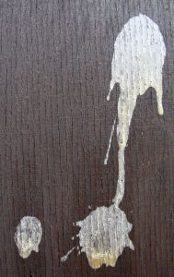
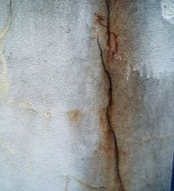
Types of soil
For the purpose of general cleaning, this is how soil is categorised:
Litter
Dust
Dirt
Staining
Tarnishing
Slide 14
Notes:
Self explanatory - Trainer to give examples of all of these in a public building.
14

Slide 15
How Do We Clean ?
Mechanical
Chemical
Combination of Both
Heat
Slide 15
Notes:
Trainer to explain that cleaning is a science which is constantly evolving.
A good knowledge of machinery, chemicals and cleaning techniques is vital
Most cleaning methods involve a combination of mechanical action either human or machine and chemicals
Heat is used for sterilisation.

Slide 16
Types of electrical cleaning machinery
There are literally thousands and thousands of different types and brands of cleaning machines on the open market. It is important to use the best you can afford.
The most common ones you will use are:
Vacuum cleaners
Scrubbing machines
High speed polishing machines
Carpet cleaning machines
Steam cleaners
Slide 16
Notes:
Trainer should discuss in detail the operation of each machine.
The use of these include mechanical action.
Class activity 5
If possible have one of each machine in class to demonstrate to students.
16

Slide 17
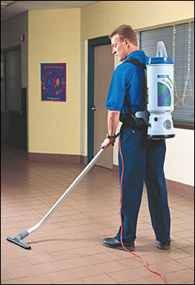
Types of vacuum cleaners
Uprights
Barrel
Canisters
Wet vacuums
Backpack
Stick vacuums
Hand held
Slide 17
Notes:
Trainer to discuss that in hotels, carpet will probably occupy 60% of al flooring.
The vacuum cleaner is the most important piece of electrical equipment used by the professional cleaner and should be well cared for.
17

Slide 18
Types of other electrical cleaning equipment
Scrubbers
Polishers
Carpet cleaning machines
Upholstery cleaning machines
High pressure washers
Steam cleaners
Portable dryers
Blowers
Slide 18
Notes:
Trainer to explain that scrubbers are usually classified as slow rotation machines (approximately 150 rpm-300 rpm).
Polishers can vary from 150 rpm to 2500 rpm
The latter (2500 rpm) are classified as burnishers which are only used to polish floors
The slower rotating machines can be used to scrub, strip floors (remove polish ), polish and buff floors (Buffing is a maintenance method of cleaning the floors between strip and polish procedures).
Buffing may be done daily or weekly where strip and polish is done as needed, depending on the amount of foot traffic. Maybe every 3 or 6 months
Trainer to discuss other types of machinery and where they will be used.
18

Slide 19
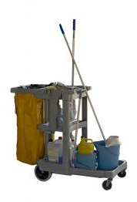
Non-electrical heavy equipment
Sweepers
Carpet sweepers
Trolleys
Slide 19
Notes:
Trainer to discuss the different types of sweepers (manual, battery driven and ride on).
Trainer should get brochure samples or pictures of different styles of cleaners trolleys and discuss what items should be placed on them and how they should be stacked neatly and in clean condition.
19

Slide 20
Other cleaning equipment (1)
Mops and Buckets
Brooms and brushes
Dustpans
Feather Dusters
Wet floor signs
Slide 20
Notes:
Trainer to discuss various styles of mops and buckets, brooms and brushes.
Wet Floor signs or signs with Cleaning in Progress are vital as they alert guests and staff to possible hazards.
Dustpans may also include lobby pans which are the long handled style. These are for cleaning areas where there is always litter or cigarette butts.
It prevents the cleaner from having to bend all the time.
Continued next slide
20

Slide 21
Other cleaning equipment (2)
Nippers
Chemical bottles
Cleaning cloths
Scourers
Sand sieve
Slide 21
Notes:
Trainer to discuss.
Chemical bottles will be discussed later with selection of chemicals but mention that the bottles should ALWAYS be correctly labeled with the contents
A nipper is a piece of equipment used to pick up bottles and litter without touching it or bending. From here it is placed in to a garbage bag. It prevents the cleaner from having to bend all the time
A sand sieve is used to clean sand that is used in ashtrays
Scourers can be nylon or polyester and are abrasive pads - the darker the colour, the harsher they are. Green and white are used in most day to day tasks. Scourers should never be used on plastics or laminate. Brown and black are used in kitchens to remove grease.
21

Slide 22
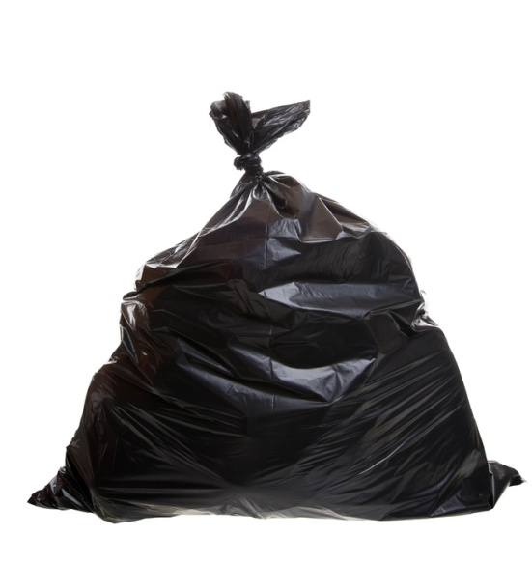
Cleaning Accessories
Toilet rolls
Paper towels
Light globes
Garbage bags
Bin Liners
Sanitary bags
Roller towels
Tissues
Soap
Slide 22
Notes:
Cleaning accessories are very important during the cleaning process
All staff must be able to replace vital guest supplies like soap and toilet rolls as needed
Collection of rubbish must be done on a regular basis so garbage bags and bin liners are a part of the cleaning process.
Class activity 6
Suggest the trainer invite a guest speaker from a cleaning accessory company to discuss the wide variety of miscellaneous cleaning equipment and accessories available.
22

Slide 23
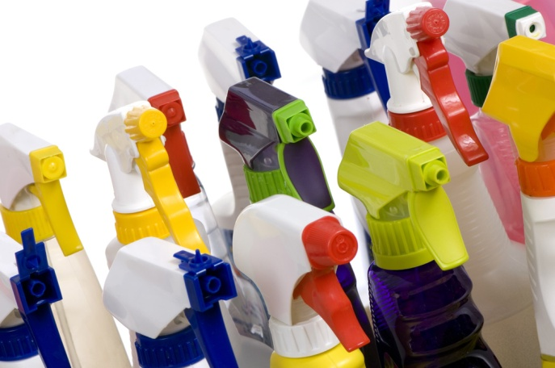
Cleaning Chemical knowledge
Presented by
From
Slide 23
Notes:
Class activity 7
Trainer to invite a guest speaker from a reputable cleaning chemical supplier to discuss all aspects of use, selection, storage and safety.
23

Slide 24

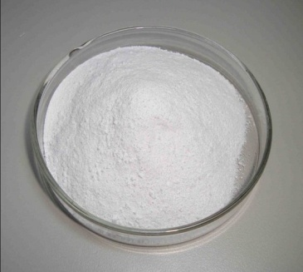
Types of cleaning chemicals
Acids
Alkalis
Abrasives
Detergents
Bleaches
Disinfectants and Sanitisers
Polishes
Solvents
Slide 24
Notes:
Trainer to link this slide with the discussions with the chemical supplier representative and slides 25 and 26.
24

Slide 25
The W.A.T.C.H. principle
WATER - Holds the dirt in suspension with the addition of chemicals. It is a good rinse aid BUT it is heavy and can damage surfaces
ACTION - Mechanical action - human or machine
TIME = Cost, but chemicals need time to work
CHEMICAL - Different types for different soils.
HEAT - Hot water increases chemical activity - sterilisation
Slide 25
Notes:
Water is a necessary addition to most chemicals as it helps the chemical to penetrate the soil and hold it in suspension so it can be easily rinsed away
Care must be taken when using water on wood floors as it is can swell the wood. Take care not to over wet carpets
Water is heavy and can cause damage if not used correctly
Hot water will increase the activity of most chemicals.

Slide 26
Safe Handling of Chemicals
NEVER mix any chemicals
Follow manufacturer’s instructions re dilution rates/uses
Wear protective clothing
Correct labeling
Clean up spillages promptly
Slide 26
Notes:
Trainer to stress that chemicals should NEVER be mixed.
One may render the other inactive but also can cause a chemical reaction which can give off fatal gases
Always follow the instructions for use and know the purpose of each one
Refer to the general precautions in the Trainee Manual.

Slide 27
Protective Clothing and Equipment
Always wear and use the correct protective clothing and equipment for the task you are performing.
Decanting chemicals
Cleaning bathrooms
High pressure washing
Carpet cleaning
Using noisy equipment (blowers)
Slide 27
Notes:
Trainer to hold a general discussion on what to wear and when.
If possible have some examples to show the students.
27

Slide 28
Prepare to clean
Have all equipment you need for cleaning
Assess area for damage
Use caution signs and barriers
Remove furniture
Cover furniture
Slide 28
Notes:
Trainer to explain that good preparation will save time in the long run.
28

Slide 29
Undertake the cleaning process
Remove all waste
Dry tasks
Wet tasks
Clean top to bottom
Floor cleaning last
Work systematically
Final check
Slide 29
Notes:
Trainer to explain that working to a routine will ensure that no tasks are missed and all surfaces will be cleaned.
A routine will ensure that time is not wasted backwards and forwards changing chemicals and equipment
At the end of the day, the cleaner will also be less tired.
29

Slide 30
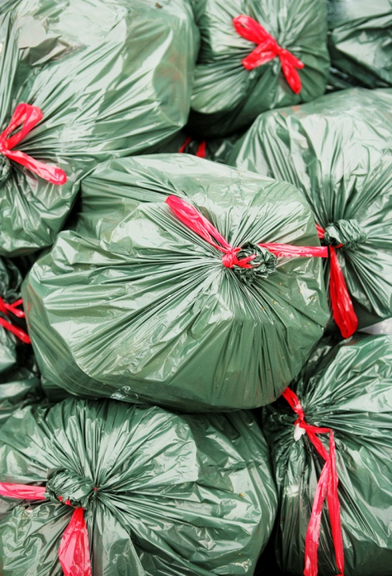
Dispose of waste
Types of waste:
Food waste
Dry waste
Recyclable waste
Medical and infectious waste
Return waste
Slide 30
Notes:
Trainer to explain that disposal of waste is a very important task.
Explain that f waste is not disposed of correctly, it may attract vermin and pests and generate bad odours.
Class activity 8
Suggest trainer arrange a visit to either a waste disposal plant to see how all waste is disposed of or a visit to a recycling plant to create awareness in the students of the need to recycle and reduce costs of general waste disposal.
30

Slide 31

Clean, check and store cleaning equipment and chemicals
Clean and check all equipment
Store tidily
Empty and wash buckets and mops
Clean all brushes
Store all similar items together
Clean and restack trolley
Remove any waste
Refill chemical bottles
Sort cleaning cloths
Check protective equipment
Slide 31
Notes:
Trainer to discuss these issues explaining that good teamwork between cleaners will make their tasks easier for the next day as the cleaners store will be neat and tidy, all equipment in working order and everything in its place will save time and effort.
31

Slide 32
Care of the Vacuum cleaner
Empty cloth dust bag or replace paper bag daily
Damp wipe exterior of machine
Check wiring/switches daily for faults
Oil squeaky wheels
Replace filters regularly
Regular maintenance
Slide 32
Notes:
The vacuum cleaner should be well maintained
Always place the full paper dust bag into a plastic garbage bag to eliminate dust being spread around
The machine should be checked daily for frayed or damaged wiring
Report faults as soon as they occur and take a machine out of service if it presents as a hazard
Squeaky wheels or an overly noisy motor may disturb guests and staff.

Slide 33
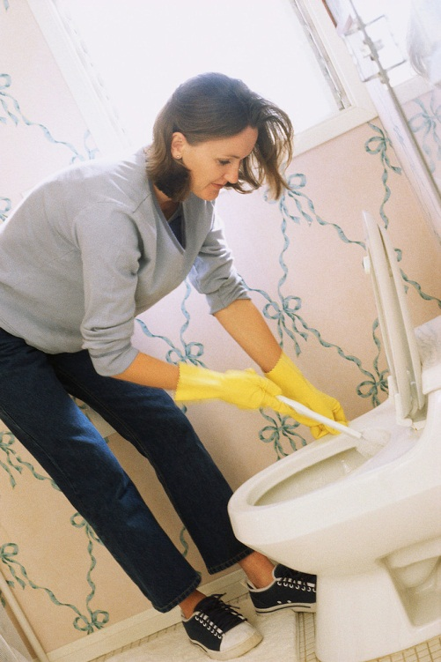
Wet cleaning tasks
Toilet cleaning
Washroom cleaning
Bathroom cleaning
Mopping floors
Pressure washing
Dishwashing
Scrubbing
Carpet and upholstery cleaning
Window cleaning
Slide 33
Notes:
Trainer to discuss different wet tasks and the equipment and chemicals that would be needed for each.
Trainer to demonstrate the correct cleaning of a) a toilet and b) a wash basin and point out all the details that determine if these areas are clean or not (tops of lid and seat, underneath of the lid and seat, around the pan and underneath, the throat of the toilet and under the rim, any pipes behind and the flush buttons or handles).
Dry and polish - for a washbasin around the taps and plug, no hairs or cigarette butts, overflow outlet, pipes underneath, the underneath of the basin.
33

Slide 34
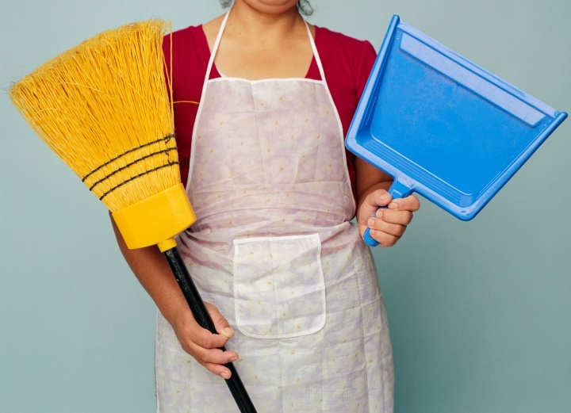
Dry cleaning tasks
Vacuum cleaning
Dusting
Dust mopping
Polishing
Buffing
Dry cleaning
Sweeping
Blowing
Empty ashtrays
Pick up litter/ waste removal
Slide 34
Notes:
Trainer should demonstrate the correct standing position when vacuuming (keep back straight and let the machine do the work - do not “scrub” the carpet with the machine.
When dusting dampen the rag and spray the polish or all purpose cleaner on to the rag. This will be enough and economical.
Demonstrate the figure 8 of dust mopping an area without lifting the mop off the floor.
34

Slide 35
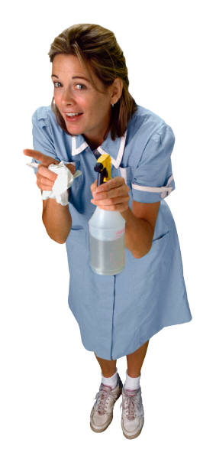
Types of Maintenance
Maintenance tasks are endless but can be summarised as
Urgent
Preventative
Planned
Slide 35
Notes:
Trainer to discuss.
All maintenance tasks need to be prioritised in order of urgency
Preventative is designed to prevent breakdowns and planned is usually larger tasks that need more time to be done at unusual times.
Class activity 9
Select an area and have the students identify all items that would need preventative maintenance by an electrician.
35

Slide 36
Types of tradesmen needed (1)
Air conditioning and heating specialists
Water treatment technicians
Upholsters
Carpet layers
General hands
Slide 36
Notes:
Trainer to discuss the different tasks to be carried out by each.
36

Slide 37
Types of tradesmen needed (2)
Electricians
Plumbers and gasfitters
Carpenters
Painters and decorators
Mechanical engineers
Slide 37
Notes:
Continue as previous slide.
37

Slide 38

Receive tasks
Tasks are reported in several ways and should be attended to as soon as possible:
From the guest
From all departments
By telephone
By written worksheet
By computer
Slide 38
Notes:
Trainer to discuss in more detail.
38

Slide 39
Perform tasks
As soon as possible
Work neatly
Work safely (use correct equipment)
Wear protective clothing if necessary
Never perform tasks you are not trained to do
Never use equipment or tools you are not trained to use
Slide 39
Notes:
Trainer to discuss.
Certain tasks should be carried out only by qualified people
To attempt to complete tasks you are not trained for may harm you or others or may damage property.
39

Slide 40
Communicate when the task is complete
It is important to always let the complainant know when a task is completed so that:
The area can be cleaned
The area can be re-used
Guest rooms can be resold
Slide 40
Notes:
Trainer to explain that maintenance staff have a critical role to play when areas are out of service due to a fault.
It may increase the workload for others but it is vital that there is good communication with all departments
E.g. if the main dishwasher in the kitchen is not working , it will cause inconvenience to the kitchen staff
If the machine has been fixed but this is not communicated, then there will a backlog of dirty dishes that could have been washed earlier
This may also cause departments to incur overtime as they need to catch up
Similarly, if Housekeeping is holding a room back because of a blocked toilet and nobody tells them the problem is fixed, the hotel could lose revenue due to the room not being available.
40

Slide 41
Store maintenance items and equipment
There is a large amount of cost involved in equipping a maintenance department.
Control all tools – these may be identified by a stamp or engraving per trade
Secure them when not in use
Always check at the end of the day that they are in good working order and none are missing
Ensure there are enough consumables at all times for all trades
Slide 41
Notes:
This is self-explanatory.
Cost to the hotel is enormous if staff do not care for their equipment and it needs to be replaced
If there are not always the consumables needed, the tasks will be delayed and complaints may occur and revenue may be lost.
41

Slide 42
Perform administrative tasks (1)
Maintenance manuals
Machine record cards
Maintenance schedules
Jobs completed per trade
All utility costs
Copies of all inspections and outcomes
All contractor contact details
Slide 42
Notes:
Trainer to discuss all points.
42

Slide 43
Perform administrative tasks (2)
Monthly stock takes
Staff records and payroll costs
Purchase orders
Machinery repairs
Emergency contacts
Boiler service records
Departmental costs
Slide 43
Notes:
Trainer to discuss all the necessary record keeping.
43

Slide 44

Assist with special projects
Maintenance is involved in many activities other than day to day maintenance
Upgrade to rooms
Upgrade to public areas
Replacement of major equipment
Refurbishment projects
Exterior building maintenance
Slide 44
Notes:
Because maintenance staff know the layout of the building and the location of all plant and equipment, they must be involved with new projects when it involves upgrades and replacements within the building so that mishaps and accidents do not happen
Long term they will be responsible for the upkeep of any new equipment.
44

Slide 45
Liaise with external contractors
Liaison with contractors is vital particularly in maintaining certain types of machinery.
Plan the special work
Assist the contractors where possible
Manage the parameters of each contract
Ensure contractors work in a safe manner
Slide 45
Notes:
Keep all necessary records of planned maintenance and call outs with reasons and cost
Review all contracts regularly to ensure that the best service for the price is obtained
Discuss advantages and disadvantages of using contractors.
45

Slide 46
Types of contracts
These are many and varied but may include:
All plants
Washroom hygiene
Refrigeration maintenance
Waste contractors
Window cleaners
Lift maintenance
Pest control
Air conditioning
Window cleaning
Fire fighting equipment
Slide 46
Notes:
Trainer to ask students if they have other contracts in their workplace.
46

